Slide 1

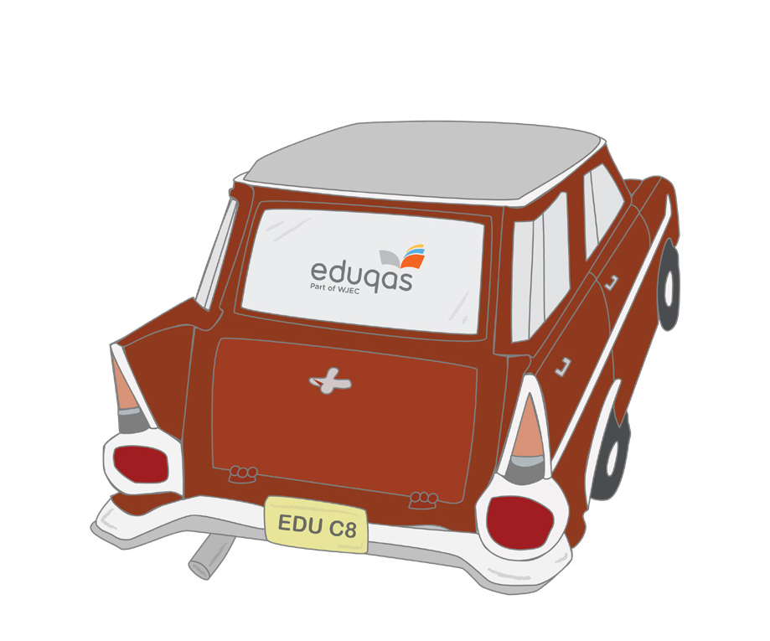

YOUR
JOURNEY
TO BECOMING EXAM READY
WELCOME TO
GCSE FOOD PREPARATION
AND NUTRITION
Find out more at www.eduqas.co.uk/qualificatins/food-preparation-and-nutrition-gcse

Slide 2
The WJEC Eduqas GCSE in Food Preparation and Nutrition will equip you with the knowledge, understanding and skills required to cook and apply the principles of food science, nutrition and healthy eating. It encourages you to cook a range of dishes, and will enable you to make informed decisions about food and nutrition and will allow you to acquire the knowledge and understanding you will need in order to be able to feed yourselves and others affordably and nutritiously, now and later in life.
Studying this qualification in food preparation and nutrition will enable you to make connections between theory and practice so that you are able to apply your understanding of food science and nutrition to practical cooking.The content relates to the study of both food and drinks.
This qualification will build on subject content and practical skills which you may have been taught at Key Stage 3 and provides a suitable foundation for the study of Food and Nutrition at Level 3 for example WJEC Level 3 Certificate in Food Science and Nutrition. This qualification will also provide a coherent, satisfying and worthwhile course of study for you if you do not progress to further study in this subject. In addition, the qualification will introduce you to a new way of thinking about food which could help you make informed decisions about a wide range of career pathways after GCSE`s or A levels.
PLANNING AHEAD...
Studying this qualification in food preparation and nutrition will enable you to make connections between theory and practice so that you are able to apply your understanding of food science and nutrition to practical cooking.The content relates to the study of both food and drinks.
By studying food preparation and nutrition you will be able to:
demonstrate effective and safe cooking skills by planning, preparing and cooking a variety of food commodities whilst using different cooking techniques and equipment
develop knowledge and understanding of the functional properties and chemical characteristics of food as well as a sound knowledge of the nutritional content of food and drinks
understand the relationship between diet, nutrition and health, including the physiological and psychological effects of poor diet and health
understand the economic, environmental, ethical and socio-cultural influences on food availability, production processes, diet and health choices
demonstrate knowledge and understanding of functional and nutritional properties, sensory qualities and microbiological food safety considerations when preparing, processing, storing, cooking and serving food
understand and explore a range of ingredients and processes from different culinary traditions (traditional British and international) to inspire new ideas or modify existing recipes.
Find out more at www.eduqas.co.uk/qualifications/food-preparation-and-nutrition-gcse

Slide 3

GIVE IT YOUR ALL!
TOP TIPS!
WELL-BEING GUIDANCE
Start to think about what foods you are eating and
their use in the body.
Try to analyse what foods you (and others) are eating and consider if these meet your nutritional needs and current healthy eating guidelines.
Develop practical skills at every opportunity-– there is a list in Appendix A of the specification – ask your teacher for a copy.
Think about the dishes/meals you eat and consider how these can be developed, adapted or improved.
Look at information on packaging, e.g. where foods come from, shelf life information.
Think about how foods should be stored, prepared, cooked and served - safely and hygienically.
Consider why food/ingredients act in a specific way, e.g., why does bread rise in the oven.
Watch food related programmes on-line and/or on TV to research and explore the topics you will cover in class.
Think about how technology is changing the foods we eat.
Take baby steps
Remember this is a journey and you will pick up skills and knowledge along the way.
Take regular breaks from studying Exercise, meet friends, spend time with family.
Look after yourself Make sure you are getting a balanced diet and enough sleep.
Try to stay positive Even if you don’t feel like it, a positive attitude will help you.
Remember that everyone’s different
Try not to compare yourself to others.

Slide 4
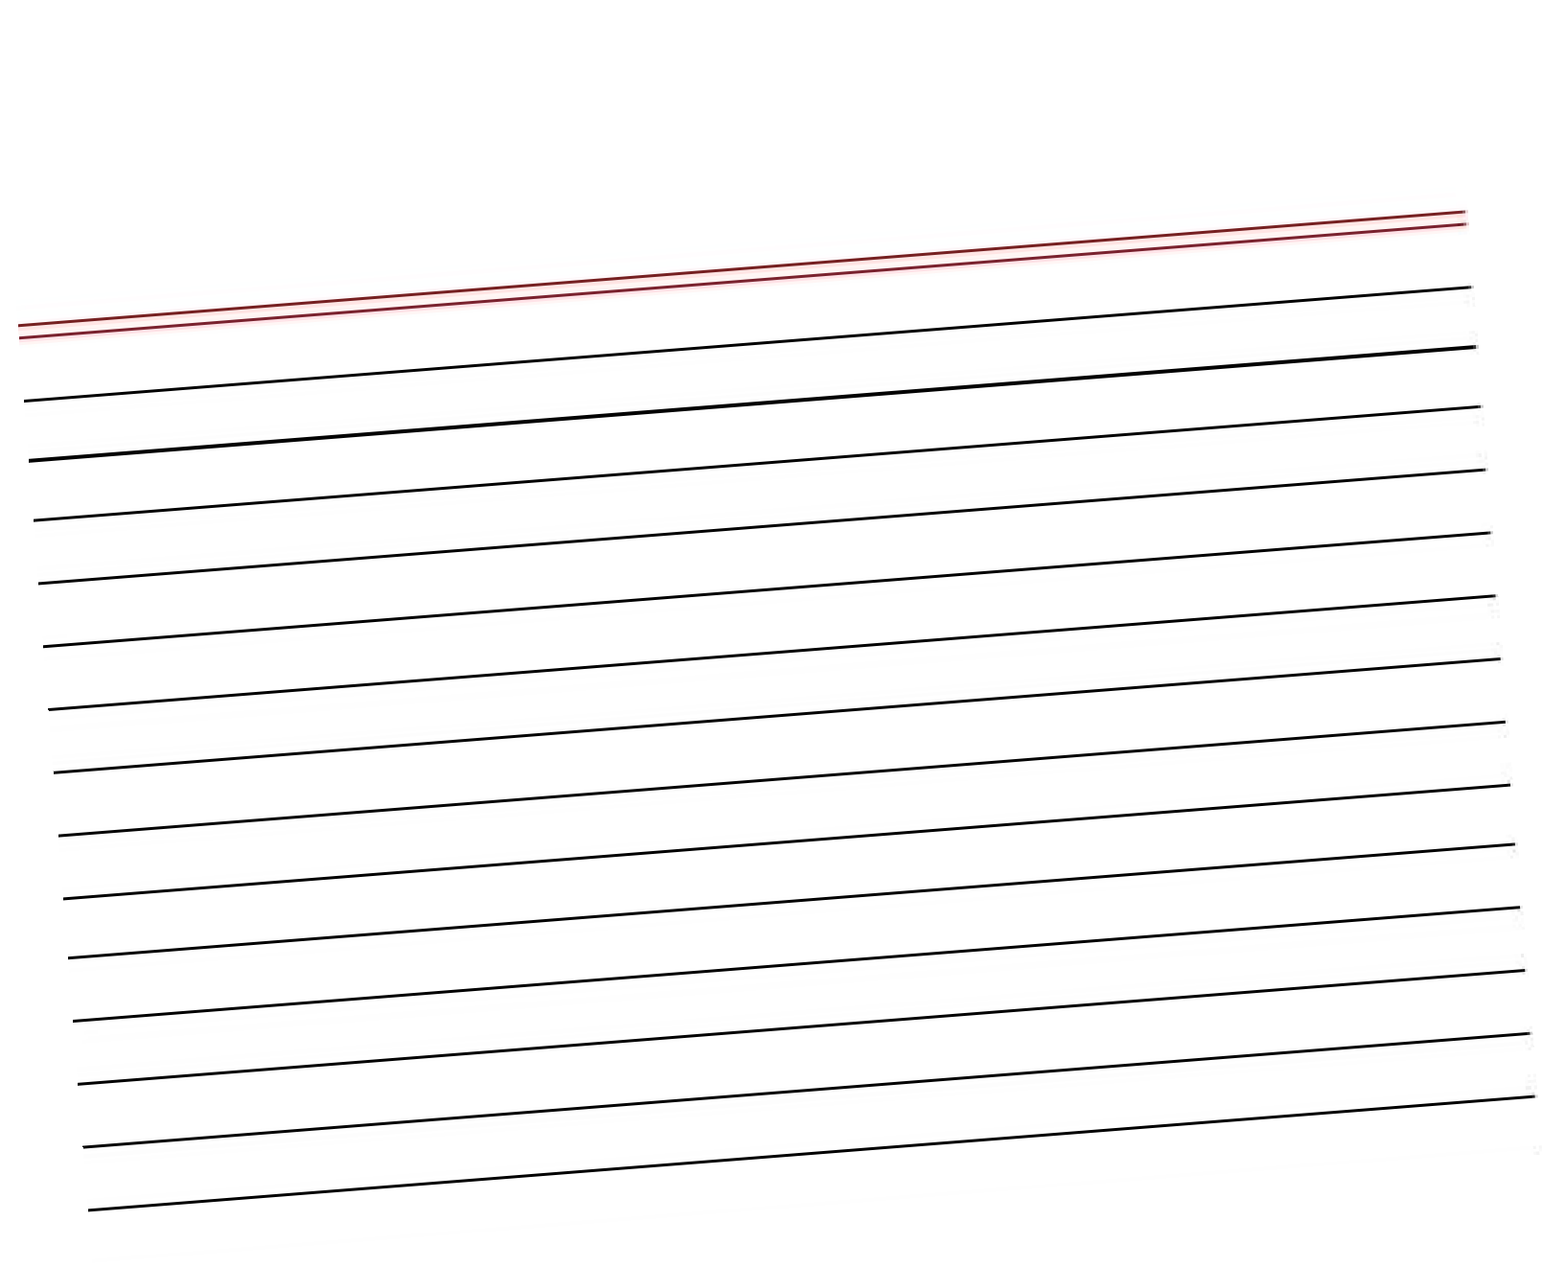
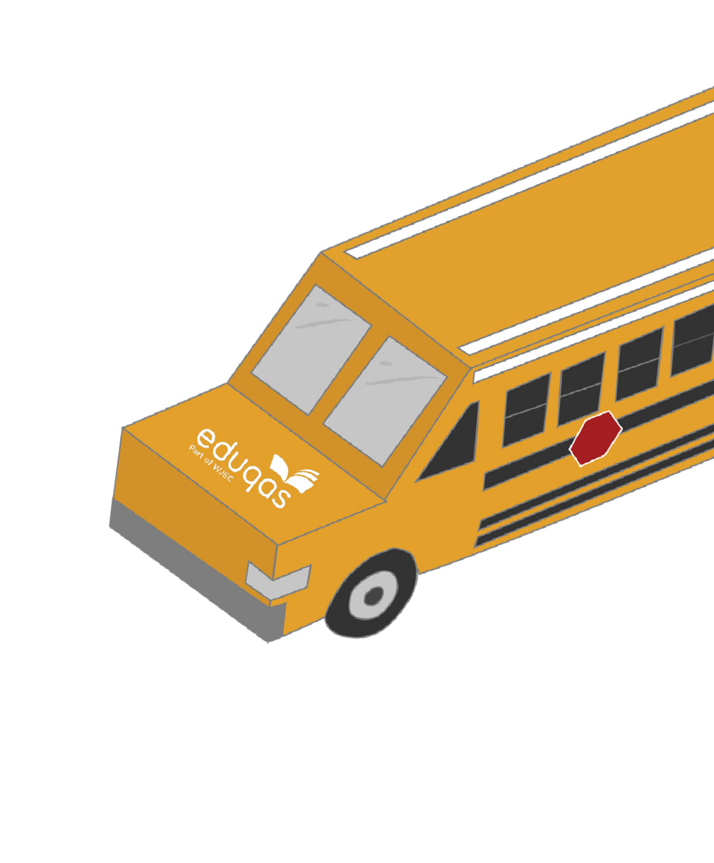
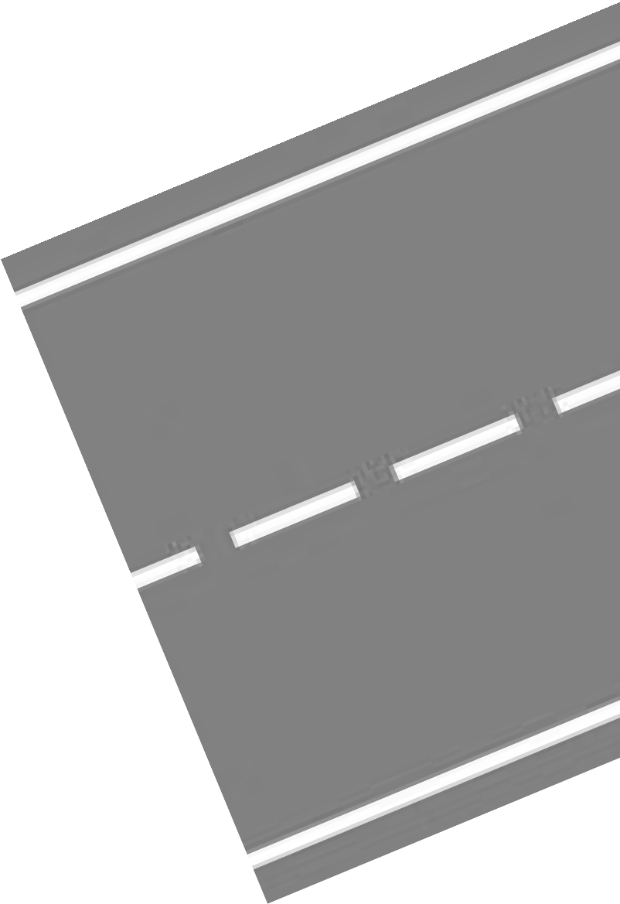


HOW ARE YOU ASSESSED?
Component 1 Principles of Food Preparation and Nutrition
There will be a written examination in the summer when you are ^{in}
year 11.
Component 2 Food Preparation and Nutrition in Action
You will need to complete two non-examina^{tion tasks (NEAs) which}
will be issued to you by your teacher when ^{you are in year 11.}
Assessment 1: A Food investigation assessment worth 30 marks
Assessment 2: A Food Preparation assessment worth 70 marks.
This includes a 3-hour practical session which will allow you to
showcase the skills you have learnt.
Find out more at www.eduqas.co.uk/qualifications/food-preparation-and-nutrition-gcse

