Slide 2
Let’s tackle the rumours. None of these are true, by the way!
Geography is easier than History.
History is easier than Geography.
You do a lot less writing in Geography than History.
It is too difficult to do both Geography and History, you should only do one.

Slide 3
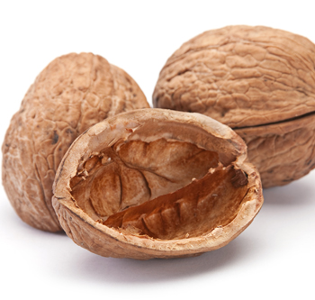
In a nutshell…
If you have enjoyed geography at EWS so far, you will enjoy doing the GCSE.

Slide 4
In a nutshell…
If you haven’t then you should pick a different subject. We won’t mind!

Slide 5
In a nutshell…
Do not just pick the subject because you did better in your recent exam than other subjects. Pick it because you want to do it.

Slide 6
It is such a varied subject
Why choose geography?

Slide 7
GCSE – how it works out – all exams, no coursework
Paper 1 – Our Natural World (35%):
Topics covered include: Earthquakes, volcanoes, hurricanes, floods – what causes them and what are their impacts? Climate change. Rivers and coasts. Why are ecosystems, rainforests and polar regions important?
Paper 2 – People and Society (35%):
Topics covered include: Cities – what challenges do they face? Why are countries poor and how can we help? UK in the 21st century. How can we feed and power the world in future?
Paper 3 – Geographical Exploration (30%) – Skills, decision-making exercise from a resource you will be given.

Slide 8
You will need to be able to…
Think logically and connect ideas together
Write well-structured answers.
Be able to interpret data and use maths
Be able to recall facts from case studies and know key terms and processes
Be able to give your own opinions and say which issues are the most important and why this is.

Slide 9
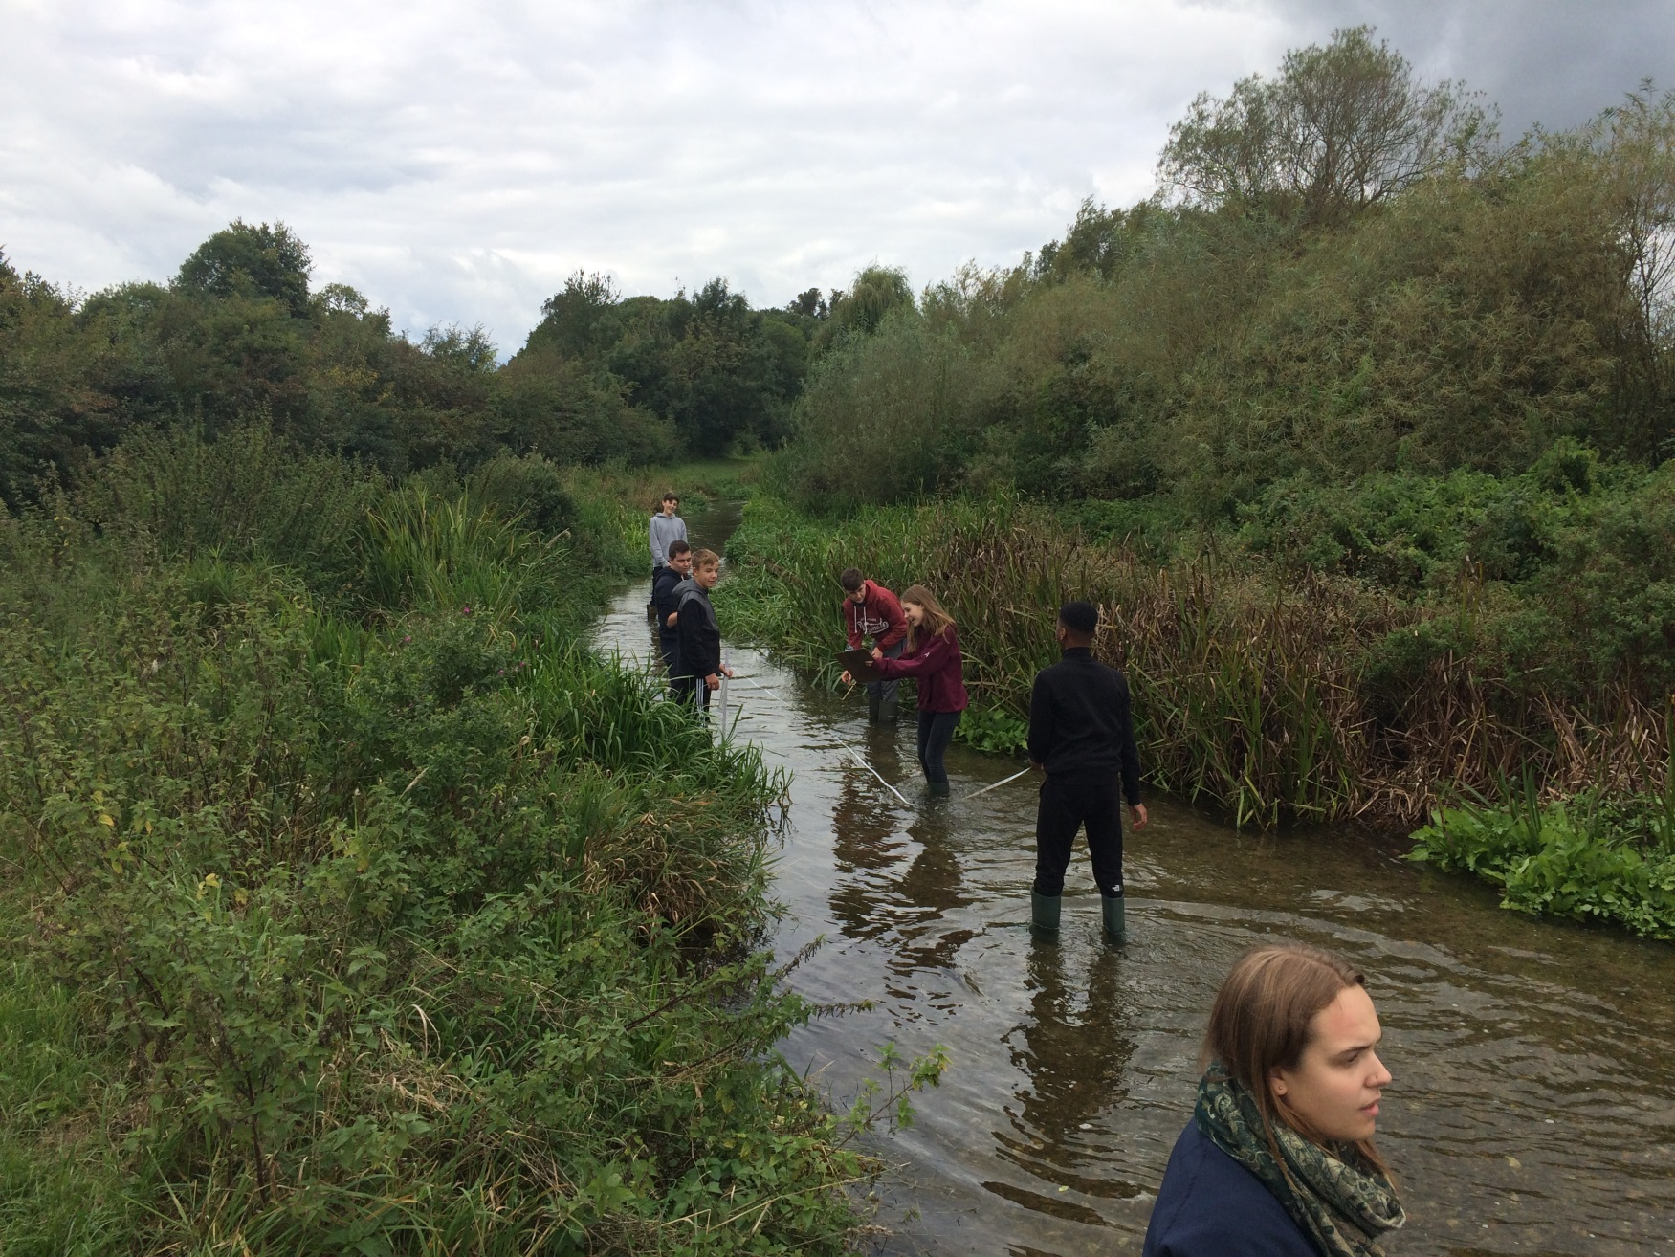
We also go out of school to do fieldwork, most recently collecting data in rivers.

Slide 10
It is a good GCSE to have
A decent GCSE geography grade tells schools, colleges, universities and employers that you are a good all-round person with lots of skills.

Slide 11
Want to know more?
See your geography teacher who will be happy to explain in more detail, show you some of the resources and give you advice on whether it is a suitable choice.

