Slide 1
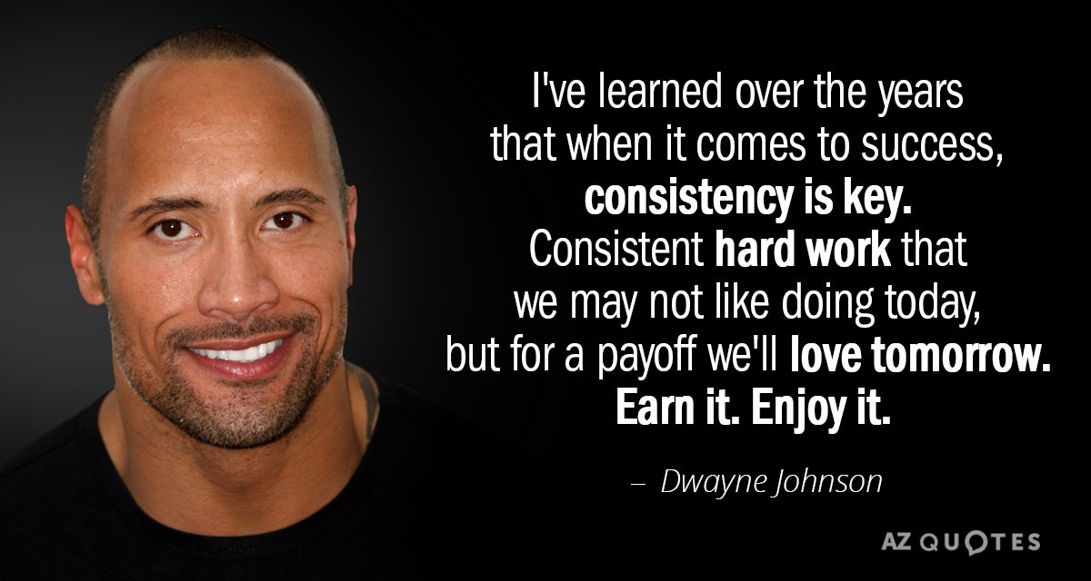

Slide 2
‘Chase your Greatness.’
‘Successful people do what they need to do, even when they don’t feel like it. Toughen up!’
Dwayne Johnson.

Slide 3
GCSE English literature
Year 9 into 10

Slide 4
Session Outline
Key GCSE information : exam boards, exam papers, content, texts, timings.
Revision Activity One: Much Ado About Nothing.
Revision Activity Two: The Sign of Four
Revision Activity Three: Animal Farm
Revision Activity Four: Poetry
Key messages from the session.

Slide 5
Why do it early?
It is very heavy on content so it makes sense to teach it during Year 9 and 10 and then complete the exam-rather than try and remember it for another year, alongside English Language.
It relieves pressure in Year 11.
Students can then focus on English Language in Year 11.
Students most likely to achieve better in both English qualifications by studying them separately.
Students can focus on other subject revision as the heavy content from Literature will be dealt with and completed.
Notes:
Gratitude to parents for trusting us and following us on the journey, relief when we have completed, support three ways, GCSE is not what it was for us. Nowhere near as heavy as it is now for students. There will be moments where they feel they cannot go on-but we have to support them through the lows.

Slide 6
Question | AOs | Marks | Weighting | Timing
Shakespeare | AO1-3 | 34 | 21.25% | 50 mins (including 10 mins planning)
C19th novel | AO1-3 | 30 | 18.75% | 50 mins (including 10 mins planning)
Modern text | AO1-3 | 34 | 21.25% | 45 mins
Anthology poetry comparison | AO1-3 | 30 | 18.75% | 45 mins
Unseen poem | AO1-2 | 24 | 15% | 30 mins (including 5 mins planning)
Unseen comparison | AO2 | 8 | 5% | 15 mins (including 5 mins planning)
Paper 1
Paper 2

Slide 7
English Literature Paper One: 1hr 45mins
Shakespeare
Much Ado | 5 min reading/planning 45 min writing 5 min to check SPaG
19th Century novel
Sign of Four | 5 min reading/planning 45 min writing

Slide 8
English Literature Paper Two: 2hrs 15mins
Modern Text
Animal Farm | 5 min reading/planning 35 min writing 5 min to check SPaG
Poetry
Anthology comparison |  | 5 min reading/planning 40 min writing
Unseen |  | 5 min reading/planning 25 min writing
Unseen comparison |  | 3 min reading/planning 12 min writing

Slide 9
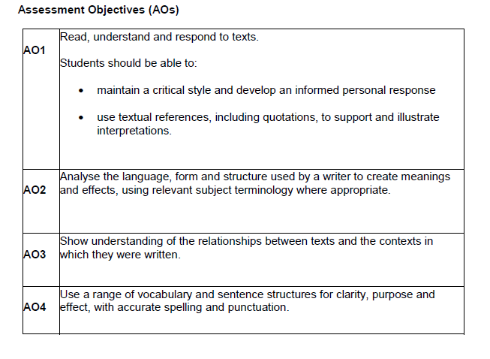
40%
40%
15%
5%
Notes:
AO1-40%, AO2-40%, AO3-15% & AO4-5%
AO1 and AO2 never separated.
The percentages are for the whole qualification-across both papers

Slide 10
Retrieval practice and why it is important.
“Retrieval practice” is a learning strategy where we focus on getting information out. Through the act of retrieval, or calling information to mind, our memory for that information is strengthened and forgetting is less likely to occur. Retrieval practice is a powerful strategy for improving academic performance without more technology or money.
WHAT IS RETRIEVAL PRACTICE?
Retrieval practice is a strategy in which calling information to mind subsequently enhances and boosts learning. Deliberately recalling information forces us to pull our knowledge “out” and examine what we know.

Slide 11
DOES RETRIEVAL IMPROVE MORE THAN JUST MEMORIZATION?
By using retrieval practice as a learning strategy, we exercise and strengthen our memory. Research demonstrates that this improvement in memory and long-term learning is flexible, which:
• Improves students’ complex thinking and application skills
• Improves students’ organization of knowledge
• Improves students’ transfer of knowledge to new concepts
In other words, retrieval practice doesn’t just lead to memorization – it increases understanding. Because students have a better understanding of classroom material by having practised using this information.
As an additional benefit, retrieval practice helps us to identify gaps in learning. In other words, not only does retrieval improve learning and help us figure out what we do know – more importantly, it helps us figure out what we don’t know.

Slide 12
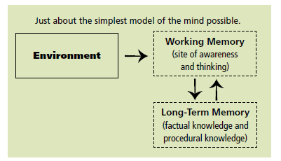
All of the information in long-term memory resides outside of awareness. It lies quietly until it is needed, and then enters working memory, and so becomes conscious.
Thinking occurs when you combine information (from the environment and from long-term memory) in new ways. That combination happens in working memory.
Notes:
Data mention here. Grades we enter in the system.

Slide 13
How to revise
Much Ado About Nothing
By William Shakespeare
Activity One:

Slide 14
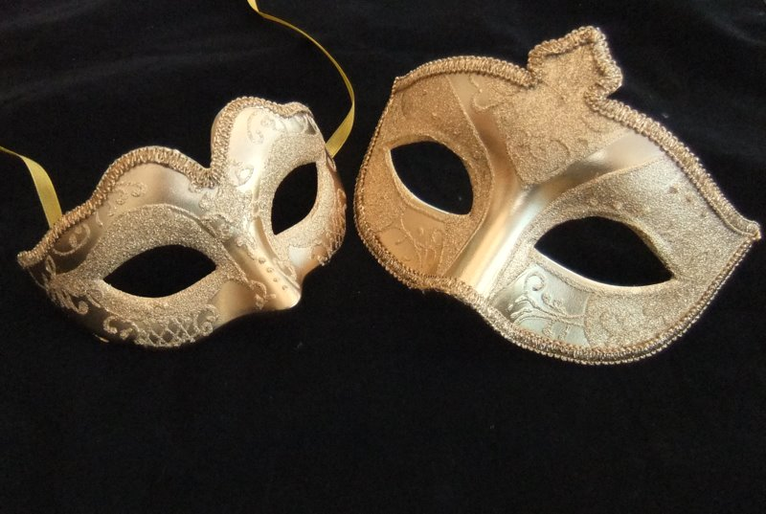
How does this image link to the play?
Which key theme is this linked to?
How does this theme explore the theme of courtly love?

Slide 15
Extension:
Who is responsible for speaking these words?
Why?
What does the quote reveal?
“Can the world buy such a jewel?”
Draw an image you would associate with this quote.
Notes:
Do on a flashcard type bit of paper to show how to do it.

Slide 16
Pictionary to revise
You can spend some time finding images for various quotes in the text.
Make sure the images are ones that will help you memorise relevant quotes.
Create Pictionary cards with the image and the quote on one side, possible questions on the other side.
Ask someone to test you with the images.

Slide 17
Pictionary to revise
Or
Write out key quotes onto flash cards with some explanation around the quote.
Revision partner reads out the quote and you draw an appropriate image, OR, you draw an image and the person has to guess the quote.

Slide 18
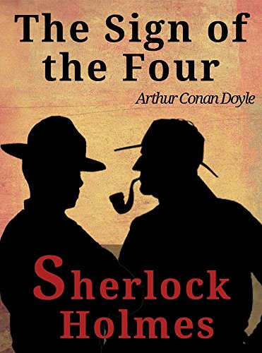
How to revise
The Sign of Four
By Arthur Conan Doyle
Activity Two:

Slide 19
Revising key characters in The Sign of Four
Character | Key actions and purpose in the novella
Sherlock Holmes
Dr Watson
Mary Morstan
Jonathon Small
Athelney Jones
Thaddeus Sholto
Bartholomew Sholto

Slide 20
Revising key themes in The Sign of Four
Themes | Key events in the novella
Crime and Justice
Duality
Imperialism
Wealth and Greed
Love and Friendship

Slide 21
How to revise
Animal Farm
By George Orwell
Activity Three:

Slide 22
Revising key characters in Animal Farm
Character | Historical Links | Key actions and purpose in the novella
Old Major
Mr Jones
Napoleon
Snowball
Squealer
Boxer/Clover
Benjamin
The sheep
Moses

Slide 23
Revising key themes in Animal Farm
Themes | Historical/Contextual Links | Key events in the novella
Power
Equality
Education
Propaganda
Leadership

Slide 24
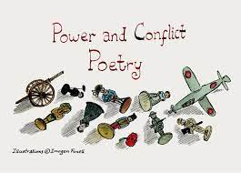
How to revise
Power and Conflict Poetry Anthology
Activity Four

Slide 25
The Fifteen Poems
Ozymandias by Percy Shelley | Charge of the Light Brigade by Alfred Tennyson
London by William Blake | Exposure by Wilfred Owen
The Prelude by William Wordsworth | Bayonet Charge by Ted Hughes
My Last Duchess by Robert Browning | Remains by Simon Armitage
Storm on the Island by Seamus Heaney | Poppies by Jane Weir
Tissue by Imtiaz Dharkar | War Photographer by Carol Ann Duffy
The Emigree by Carol Rumens | Kamikaze by Beatrice Garland
Checking Out Me History by John Agard

Slide 26
Thematic connections between poems
Themes | Poems connected by the theme.
Power
Conflict
Nature
Identity
Strong emotions
Family
Loss and absence
Negative emotions

Slide 27
Final Messages

Slide 30
My Study Planner
Day/Time | 4-5 | 5-6 | 6-7 | 7-8 | 8-9
Monday | Homework | Revision | Dinner | Revision | Free time
Tuesday | Free time | Club | Dinner | Homework | Revision
Wednesday | Club | Homework | Dinner | Revision | Revision
Thursday | Club | Revision | Dinner | Revision | Homework
Friday | Homework | Revision | Dinner | Night Off | Night Off

Slide 31
My Weekend Study Planner
Day/Time | 10-11 | 11-12 | 12-1 | 1-2 | 2-3 | 3-4 | 4-5 | 5-6
Saturday |  |  |  | Revision | Revision | Free
Sunday | Revision | Revision |  |  |  | H/wk | H/wk
Family time
Friends
Family time
Free

Slide 32
Key Messages
Start early. Do little. Do it often. Consistency is the key to transferring learning into your long term memory.
35 minutes. 5minute break. 35 minutes
Clear plan of study-have a timetable from September that includes homework, revision/study time, extra curricular time and free time.
You cannot read a text/poem once to think you know it. For an exam you must have read it three times at least so that you have the relevant information stored in your long term memory.

Slide 33
Summer To Do List
As a family read one or two of the literature texts and discuss/research the content/plot/author.
Re-read parts of Much Ado and Animal Farm and create quote cards.
Try and find showings of Shakespeare plays to watch together so that you can have the theatre experience and understanding of how devices work. The Globe 25th June to 23rd October 2022: https://www.shakespearesglobe.com/whats-on/much-ado-about-nothing-2022/#book
Research the poets we are studying from the anthology.
Create Pictionary cards with key words and quotes from Much Ado and the poems and then ‘play’ the game with family.
Visit museums with war and Victorian Britain exhibitions and talk to grandparents/ parents who have experienced war time.
Buy some nice stationery so that you are excited to begin revision.
Clear a study space that is central-so that you do not feel alone.
Notes:
Practical and helpful ways you can support over the summer

Slide 34
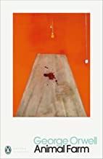
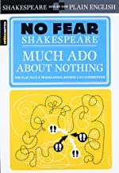
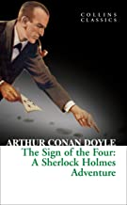
The Texts

Slide 35
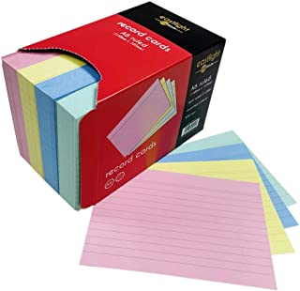
£11.99 for 400 cards (Amazon)
£5.99 pack of 5 (Amazon)
£8.99 (Amazon)

Slide 36
Thank you for your time and support. It will make a difference to the way your child approaches these exams in Year 10.
If you have any further questions please do not hesitate to speak to one of us or email.
Please take a few minutes to complete the evaluation.
Have a safe journey home.

