Slide 1
Click here and enter the login details sent to you via email
www.proactiveeducation.co.uk

Slide 2
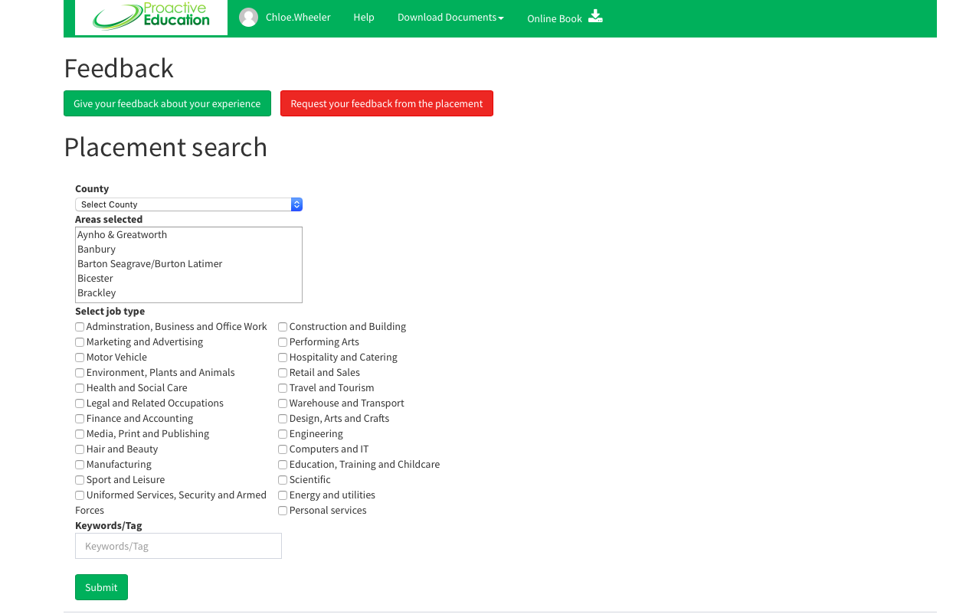
Select the county and then area that you are interested in
Then click ‘Submit’

Slide 3
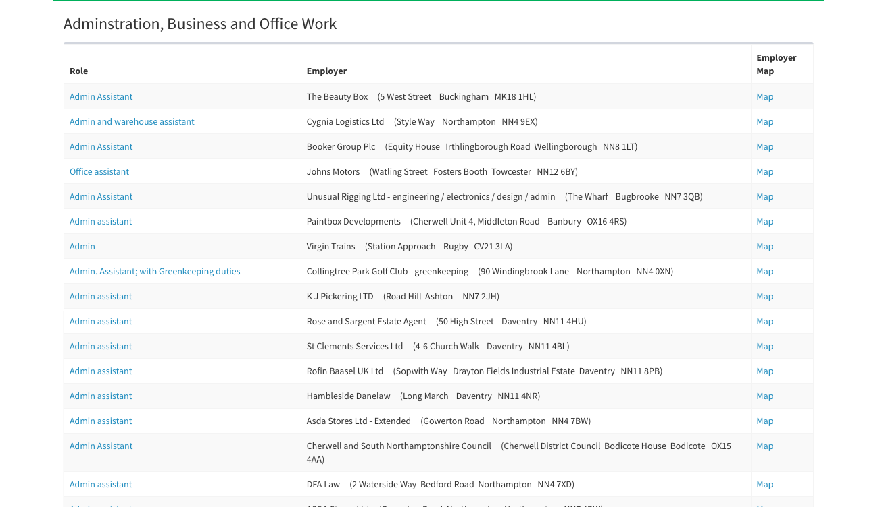
These are businesses that have previously offered work experience placements, click on them for more information.

Slide 4
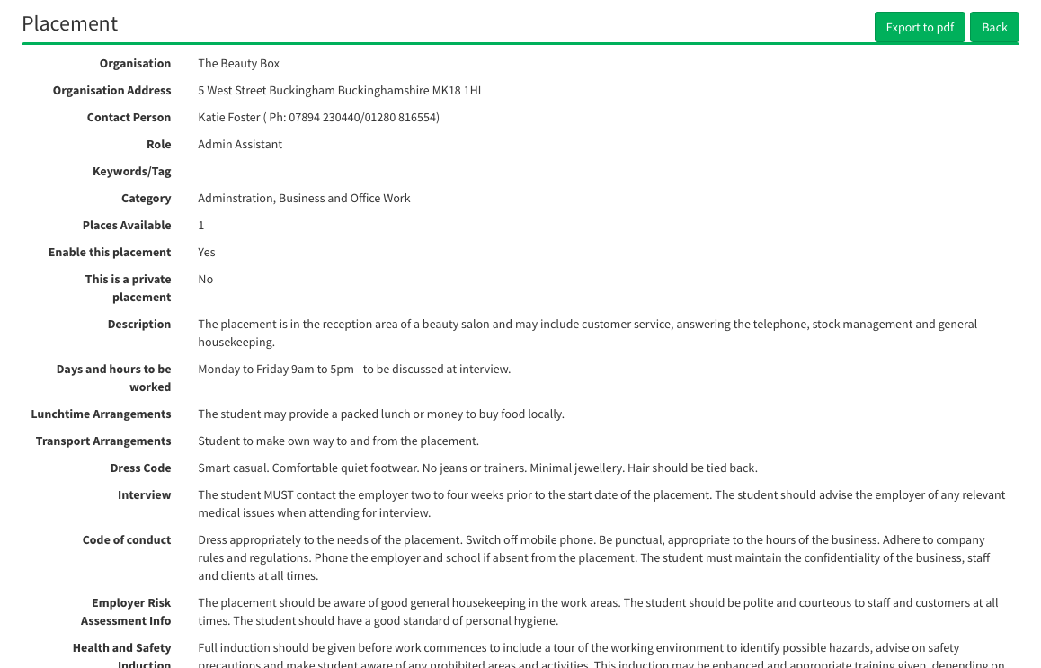
At the top you will find the contact details
You will also find the Job Description
You can export it and print if you wish

