Slide 1
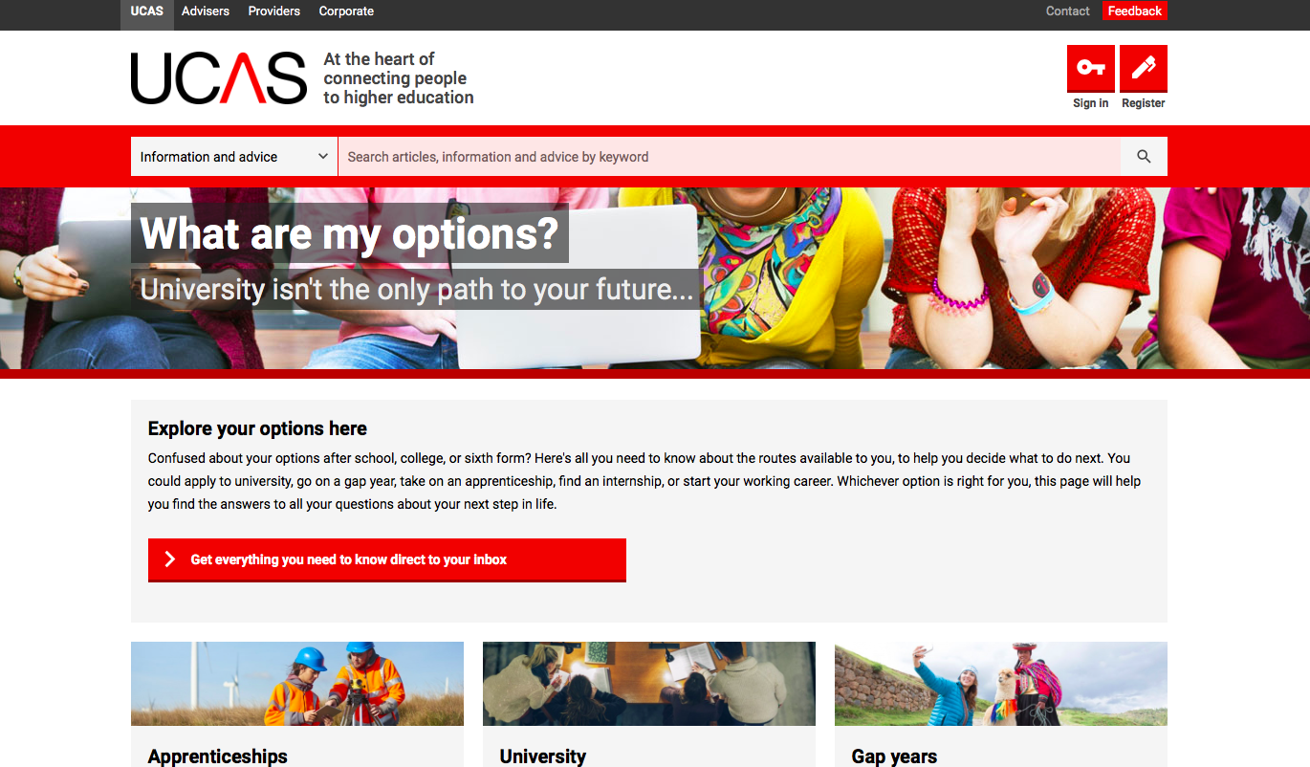
Options Post 18

Slide 2
What are the options?
THINK- PAIR- SHARE; what options are open to when you leave Sixth Form?

Slide 3
What are the options?
University
Apprenticeship
Employment
Gap Year/ Travelling
Gap Year/ Gain Further Experience
Where can I find more information? In the Sixth Form we use an online careers portal called Unifrog

Slide 4
What is Unifrog?
Unifrog is a one-stop-shop where students can easily explore their interests, then find and successfully apply for their next best step after school.
Unifrog will help you to explore your key interests and what career paths you can take to reach your goals!

Slide 5
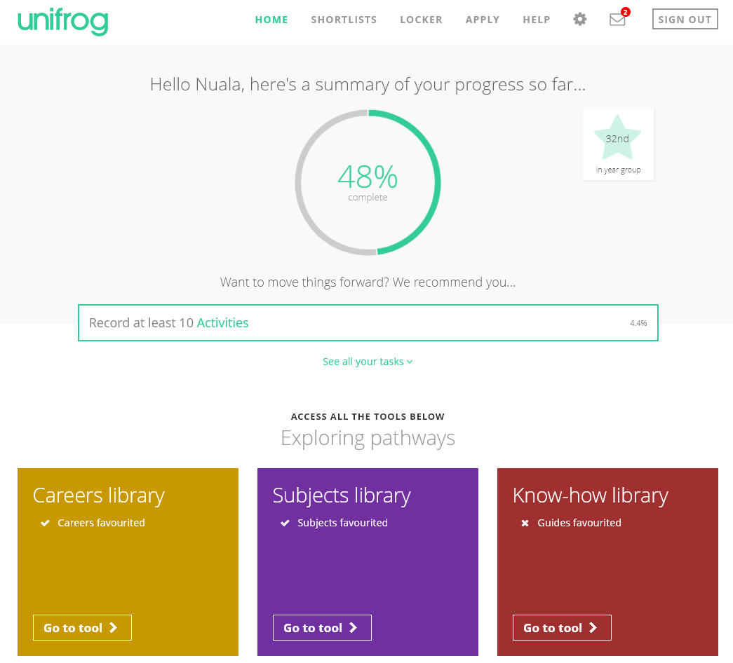
By the end of today’s session, we will have:
Understood how Unifrog can support your future decision-making and career options.
Explored some of the exciting features of the platform.
Created your very own personal Unifrog accounts!

Slide 6
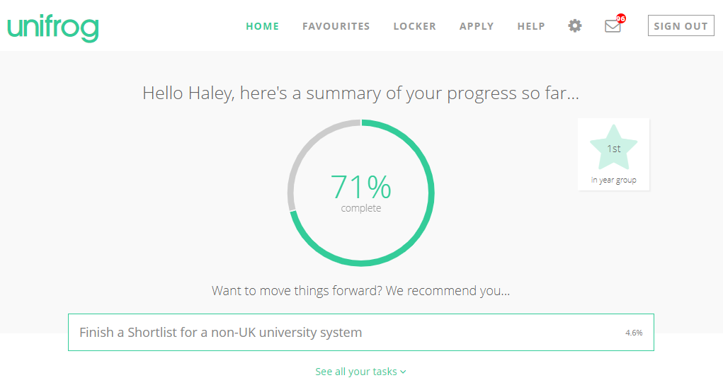
Introduction to Unifrog for post-16
Notes:
Teachers’ notes
Video – 13 minutes – Audio required
Here’s a handy video taking post-16 students on a tour of the platform! Holding Ctrl and clicking the image will take you to the Loom website to play the video.
I’ve downloaded a copy of the video just in case you do not have access to Loom.

Slide 7
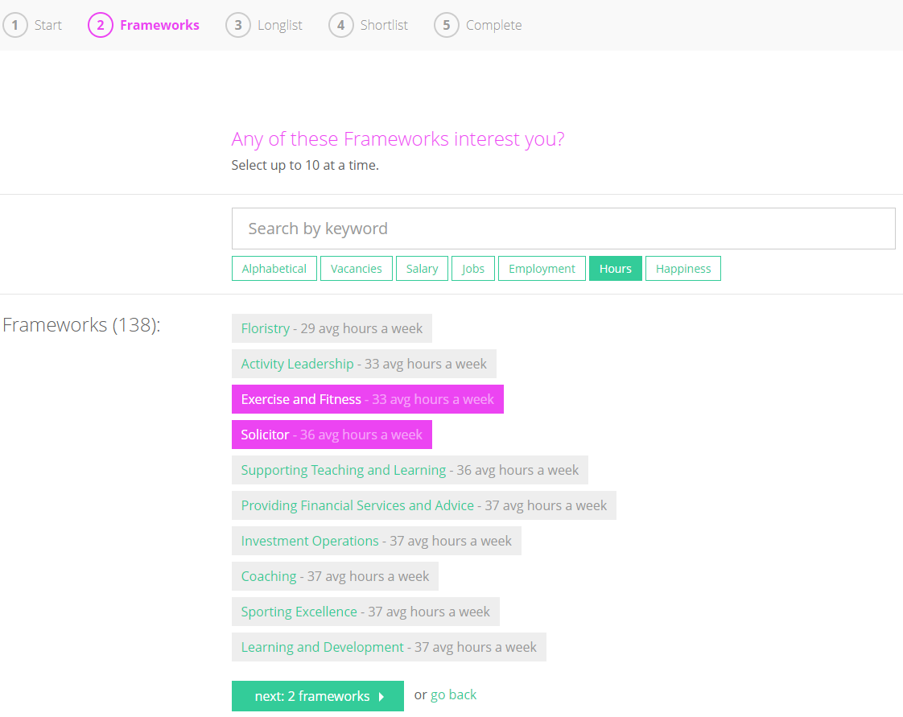
You can also find Apprenticeships that interest you
Updated every 24 hours, use Unifrog to find Apprenticeships which interest you. There are three levels of Apprenticeships available; choose the level that works for you with the qualifications you already have and what you want your next step to be.

Slide 8
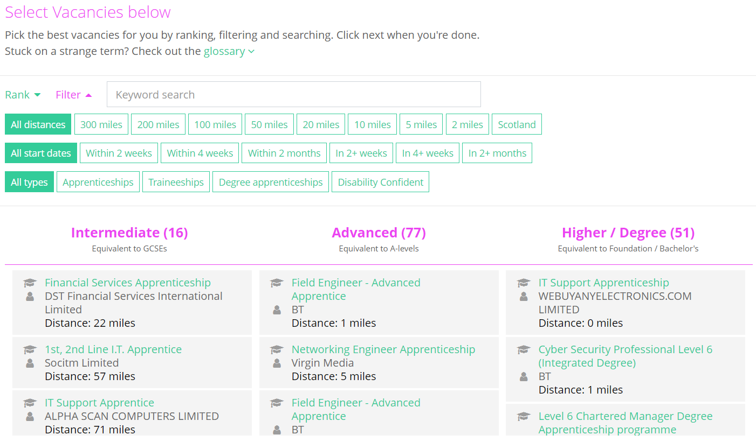
Rank and filter Apprenticeships
Rank and filter apprenticeships to narrow down your searches to what is most important to you.

Slide 9
How can Unifrog help me now?
Explore which subjects you would be interested in studying post-18 and how these choices can lead to different career paths and further education.
Discover and sign up to online courses in areas that you’re interested in.
Explore how to successfully apply to an apprenticeship or university course, including universities abroad.
Support in writing a CV and Cover letter.
Record key activities and achievements to use in your applications.

Slide 10
Creating your account
A link has been sent to your school email address (please check your junk/spam mailboxes)
Click the link and follow the instructions
Create a memorable password
Make a note of your password
Notes:
Delete this slide if you are using the form code method

Slide 11
If you can’t find your email use this link….
If you forget your password, hit the link to reset (remember to check your junk/spam just in case!)

Slide 12
Using your phone, go to the Unifrog site and login
Go to the careers and subject library to explore the options
Take the personality test and review the results for potential career pathways that may suit you

